Slide 1
Array

Slide 2
Definition
An array is data structure that acts as an temporary storage and stores data of the same type in contiguous memory location.

Slide 3
Analogy of an array
Size and Subscript/Index
Figure A is an array containing 6 elements, thus the size of the array is 6
The first element is in subscript 0 or index 0.
Zero based indexing
Index or subscript is for referencing location of each element of an array.
0, 1, 2, 3, 4, 5
0→lower bound
5-→ upper bound
Figure A
55 | 77 | 12 | 4 | 3 | 8

Slide 4
Declaring and referencing of an array
datatype arrayname[arraysize];
Thus the array in previous slide can be declared as:
int number[6];
To reference each element of the array called numbers:
number[0]=55;
number[1]=77;
number[2]=12;
number[3]=4;
number[4]=3;
number[5]=8;

Slide 5
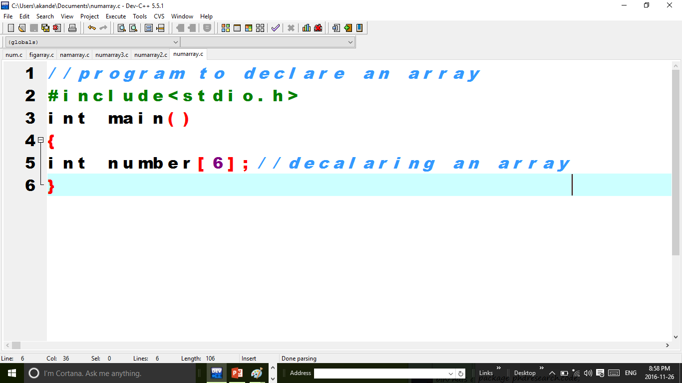

Slide 6
Initializing an array
Array can be initialized using any of the followings syntaxes:
type arrayname[arraysize]={listing each elements separated with a comma};
OR
type arrayname[]={listing each elements separated with a comma};

Slide 7
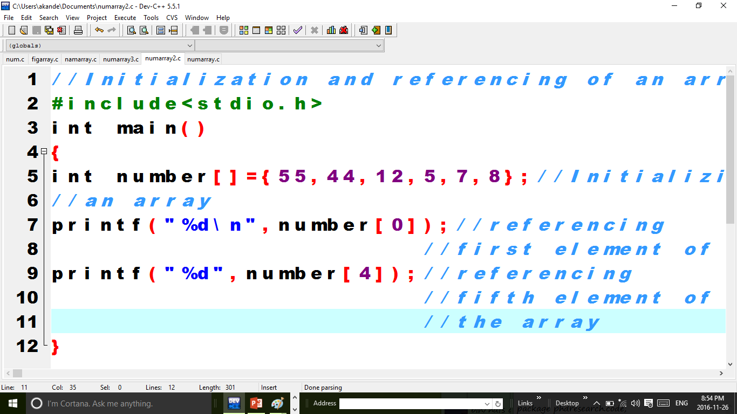

Slide 8
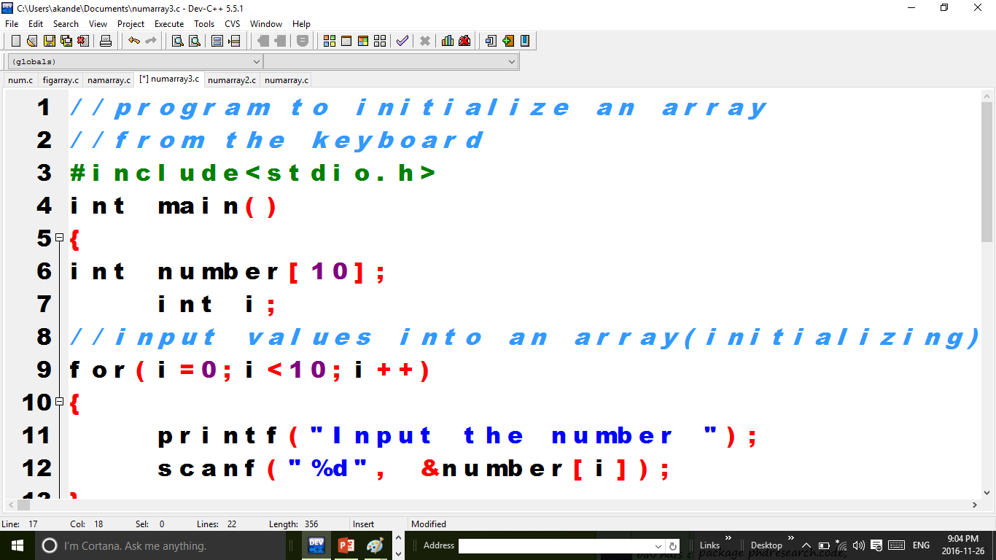

Slide 9
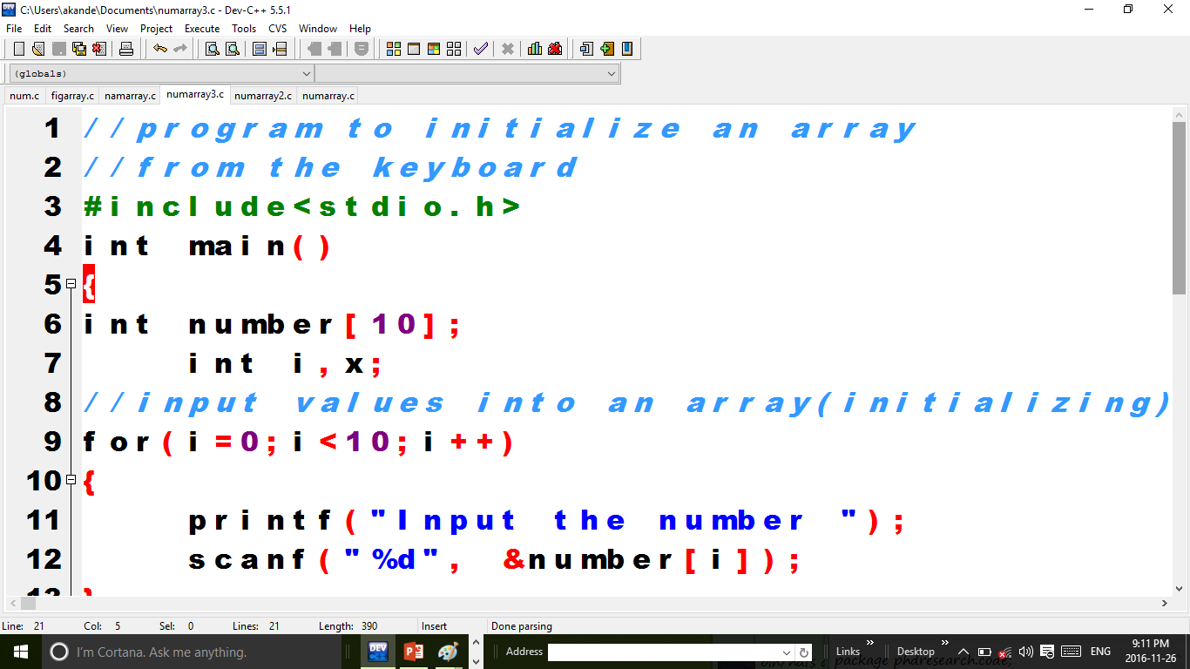

Slide 10
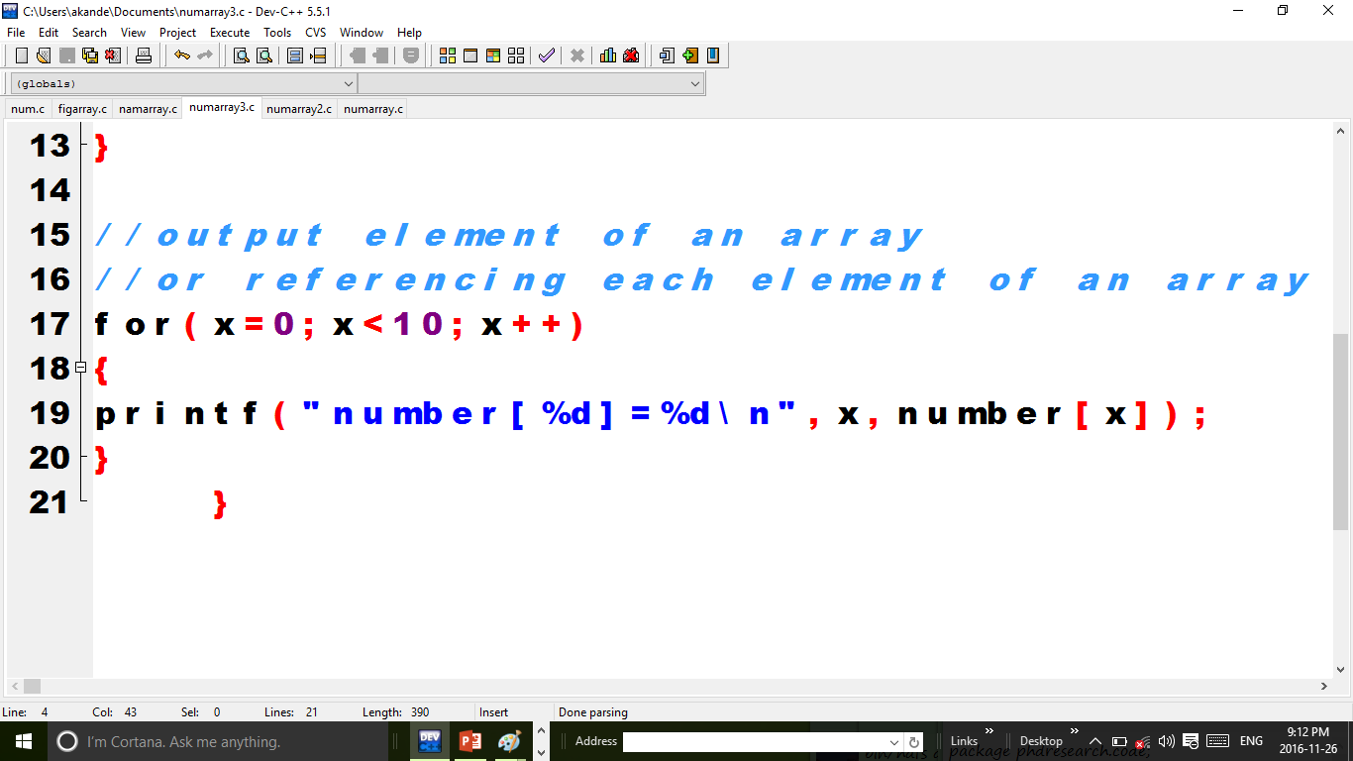
Continuation…

Slide 11
A teacher wants to record the scores of 20 pupils in arithmetic class. You are required to store the scores in an array using for loop and also to print out the scores using for loop.
7 minutes

Slide 12
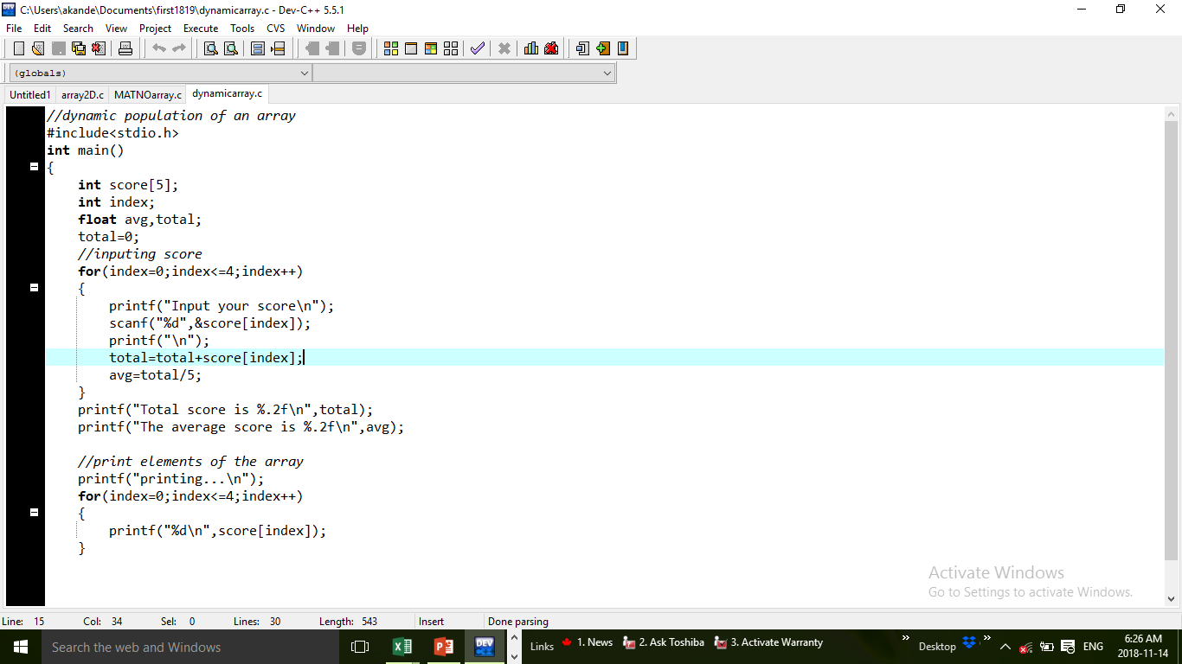

Slide 13
Two Dimensional Array
An array can be multi dimensional, an example is a 2D array
A 2D array uses row and columns
Thus, it is initialized as:
datatype arrayname[noofrow][noofcolumn];
For example to keep scores of 4 students in 2 courses, the array is declared as:
float score[4][2];

Slide 14
Example
With the aid of two dimensional array and nested for loop, develop an application that can allow user to input scores of 4 students in 3 courses. The application should also do the followings:
Compute the total score of each student
Compute the average score of each student
Output the total and average score for each student
Use another nested for loop to print out class list in a table showing student serial no, and score in each course.

Slide 15
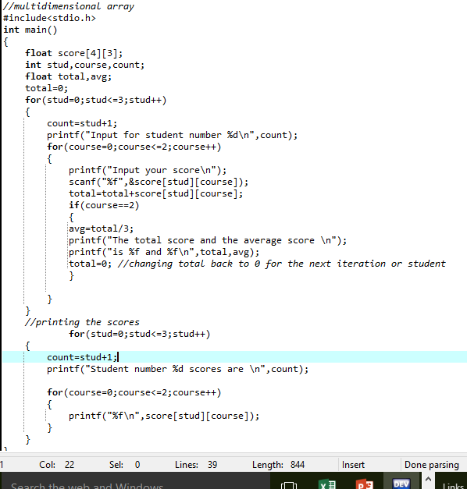

Slide 16
Note this…
When dealing with multi dimensional array the trick is in the use of nested for loop.
For example for a two dimensional array use 2 nested for loop
For a three dimensional array use a 3 nested for loop

